Slide 1
McMaster Lab Virtualization
UTS and Ron Joyce Centre

Slide 2
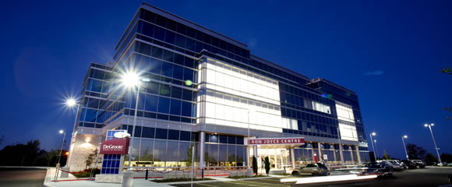
New Campus, No Lab Space
In 2010 the Michael DeGroote School of Business added a new campus building in Burlington
No student lab space was allocated
Students needed to access their course required applications
UTS was asked to
help find a solution

Slide 3
UTS Expands Citrix Farm
Decision to leverage existing infrastructure
UTS managed a Citrix XenApp 4.5 Farm provisioning financial applications for Budgeting and Human Resources.
Added 2 XenApp servers and new licenses extending the farm for RJC Students

Slide 4
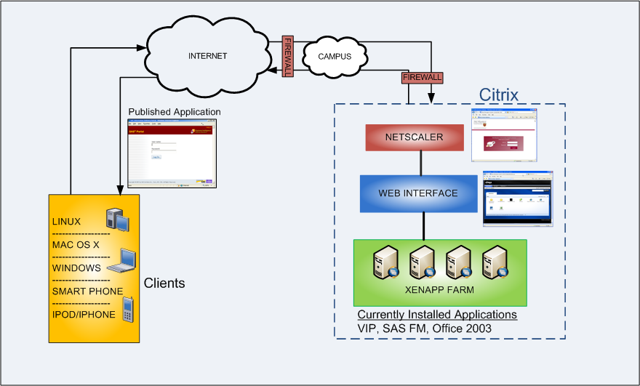
Existing McMaster Citrix Farm

Slide 5
Expanded McMaster Citrix Farm

Slide 6
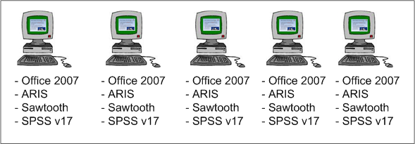
Typical Lab Desktop Installation
Use some type of imaging software to install each PC with identical software
Problems arise with software compatibility, dependencies and multiple versions.
** Riley to edit…

Slide 7
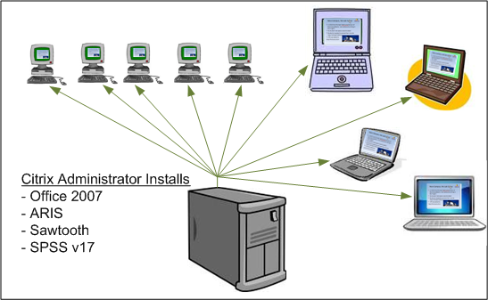
Citrix Published Application
Applications are installed on the Citrix XenApp servers and then accessed using the client browser.
Allows for remote access.
Still have problems with software compatibility, dependencies and multiple versions.

Slide 8
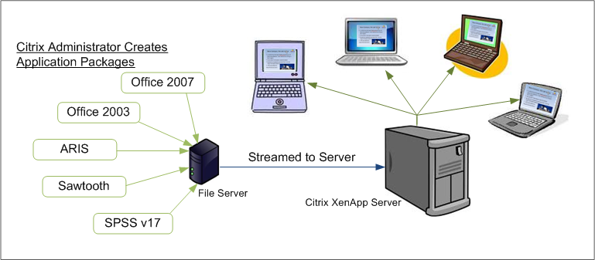
Streaming Application Installation
Applications are packaged and stored on a file server and streamed to the XenApp server eliminating problems with software compatibility, dependencies and multiple versions.

Slide 9
Performance
Usage Patterns for concurrent use
Split between evening and day students
Labs with 50 students all logging in at once
Required to use Windows 2003 32 bit

Slide 10
Continued Support
Semester turnover
Adding new applications
Updating existing applications
Citrix Client installation
Managing user accounts

Slide 11
Lessons Learned
Add user account management to faculty as much as possible
New Citrix Clients must be tested!!!
Citrix support issues for MAC or Linux
Different browsers behave differently
Once initial setup is complete – very stable and few problems

Slide 12
Lessons Learned Continued
Application specific licensing
Difficult to get applications tested
We are not ARIS experts, need cooperation with faculty
Some applications more difficult to virtualize

Slide 13
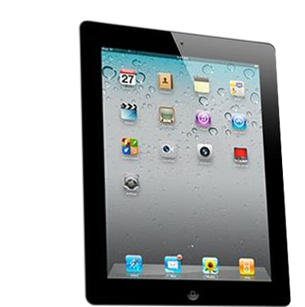
Mobile Access
Available with Citrix Receiver
iPad, iPhone, iPod
Blackberry
iPad Demo

